Slide 1

PARKINSON’S DISEASE
Presented By -
Anindita Panigrahi (CS- 201541103)
Satabdi Gantayat (CS- 201511055)
Under the guidance of
Mr. Shom Prasad Das
Ms. Sangita Acharya

Slide 2
Problem Statement
Parkinson’s disease is a disorder of the central nervous system that affects movement, often including tremors.
It affects human body in late 70’s.
We will be showing the level of affliction in the functioning of a “Person With Parkinson” (PWP) through the voice recordings provided in the dataset.
The numerical value of the status would help us in detecting the disease.
Requires medical diagnosis.

Slide 3
About Dataset
Data Set Characteristics : Multivariate.
Attribute Characteristics : Real.
Associated Tasks : Classification.
Number of Instances : 195
Number Of Attributes : 23
Missing Values : N/A
Area : Life.
Date : 26-06-2008

Slide 4
SYMPTOMS OF THE DISEASE
Primary motor signs of Parkinson’s disease :
Tremor of the hands, arms, legs, jaw, face.
Bradykinesia or slowness of movement.
Rigidity or Stiffness of the limbs and trunk.
Postural instability or impaired balance and coordination.

Slide 5
Analysis of the dataset
Composed of a range of voice measurements from 31 people.
23 with Parkinson's disease (PD).
Each column is a voice measure.
To discriminate healthy people from those with PD.
STATUS is 0 for healthy and 1 for PD.
There are around six recordings per patient, the name of the patient is identified in the first column.

Slide 6
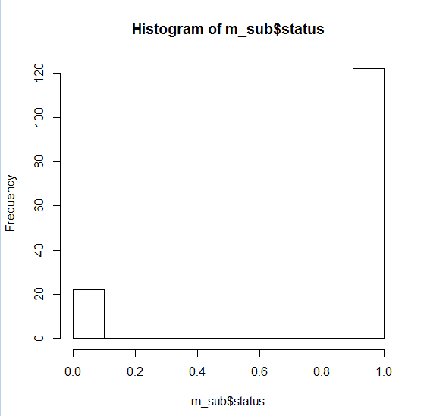
Histogram

Slide 7
Data Exploration
Understanding the data, volume, data types, input and output variables.
Summarizing the data using graph – VISUALISATION.
Identifying the missing values.
Feature engineering.

Slide 8
Attribute Information
Name - Name and recording number MDVP : Fo(Hz) - Average vocal fundamental frequency MDVP : Fhi(Hz) - Maximum vocal fundamental frequency MDVP : Flo(Hz) - Minimum vocal fundamental frequency
MDVP : Jitter (%), MDVP : Jitter (Abs), MDVP:RAP, MDVP:PPQ, Jitter : DDP - Several measures of variation in fundamental frequency
MDVP : Shimmer, MDVP : Shimmer(dB), Shimmer : APQ3, Shimmer : APQ5, MDVP : APQ, Shimmer : DDA - Several measures of variation in amplitude
NHR,HNR - Two measures of ratio of noise to tonal components in the voice STATUS - Health status of the subject (one) - Parkinson's, (zero) - healthy RPDE,D2 - Two nonlinear dynamical complexity measures DFA - Signal fractal scaling exponent spread1,spread2,PPE - Three nonlinear measures of fundamental frequency variation

Slide 9
Variable Identification
Predictor Variables :
MDVP : Fo(Hz) MDVP : Fhi(Hz) MDVP : Flo(Hz) , MDVP : Jitter (%), MDVP : Jitter (Abs), MDVP:RAP, MDVP:PPQ, Jitter : DDP
Target Variable : “STATUS”

Slide 10
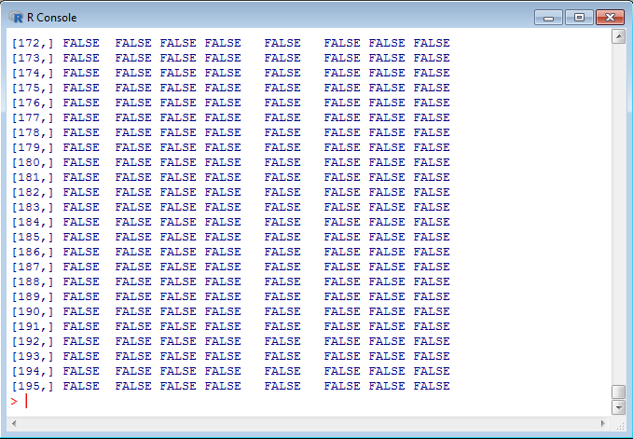
Identifying Missing Values
Is.na()

Slide 11
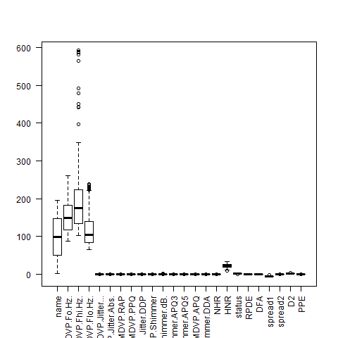
Identifying Outliers

Slide 12
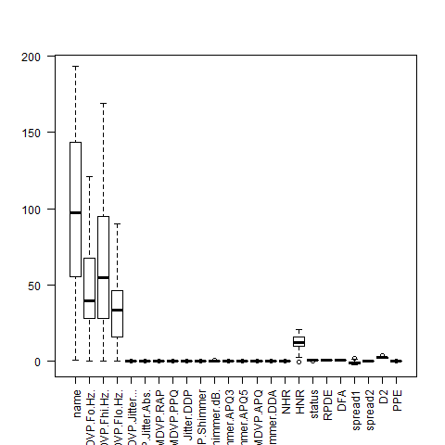
Outlier Treatment

Slide 13
Neural Network
With 1 hidden layer
With 3 hidden layers
With 5 hidden layers

Slide 14
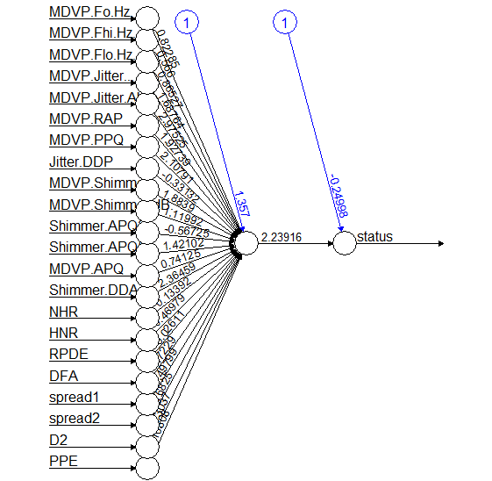

Slide 15
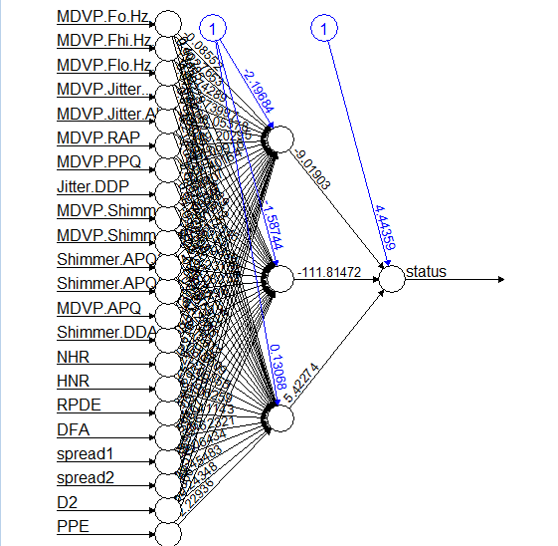

Slide 16
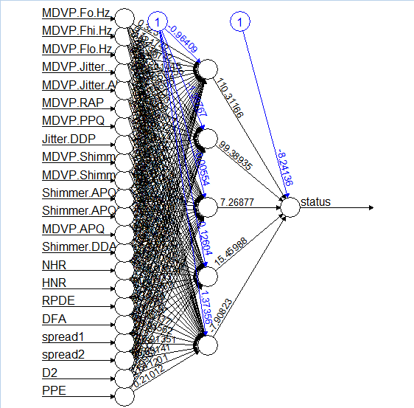

Slide 17
Miss Classification Error Rate

Slide 18
Conclusion
As this is an classification problem, we had to classify observations into either YES or NO with respect to the disease.
We successfully completed it under the guidance of Mr. Shom Prasad Das and Ms. Sangita Acharya.

Slide 19
THANK YOU !

